Slide 1
ML FRAUD DETECTION
Online Payment
Fraud Detection
Using Machine Learning
Dataset: Paytm Financial Fraud Dataset (51,623 transactions)
Models: Logistic Regression • Decision Tree • Random Forest
Fraud Rate: 0.194% — 100 fraudulent out of 51,623 transactions
ML | Classification | Imbalanced Data | AUC-ROC

Slide 2
ML FRAUD DETECTION
Problem Statement & Dataset Overview
The Paytm dataset simulates mobile money transactions based on real data. It covers 51,623 transactions across 5 types, with only 100 fraudulent cases — a severe class imbalance challenge for ML models.
51,623
Total Transactions
in Dataset
The Challenge:
100
Highly imbalanced dataset (fraud = 0.194% of all transactions)
Fraud occurs ONLY in TRANSFER and CASH_OUT types
High amount transactions dominate fraudulent behaviour
Balance anomalies are the strongest fraud signal
Fraudulent
Transactions
0.194%
Overall
Fraud Rate
5
Transaction
Types
2

Slide 3
ML FRAUD DETECTION
Key Objectives
01
02
03
Detect Fraud Accurately
Handle Class Imbalance
Compare Multiple Models
Build ML models to classify Paytm mobile money transactions as fraudulent or legitimate using transaction features.
Apply SMOTE (Synthetic Minority Over-sampling Technique) oversampling to address the 0.194% fraud rate — 100 fraud vs 51,523 legitimate transactions.
Evaluate Logistic Regression, Decision Tree and Random Forest using Accuracy, Precision, Recall & AUC-ROC.
04
05
06
Optimize Performance
Identify Key Features
Actionable Insights
Use GridSearchCV hyperparameter tuning to maximize Recall and AUC-ROC — critical for catching fraud.
Determine which features (amount, balance changes, transaction type) drive fraud detection performance.
Provide recommendations for deploying real-time fraud detection on mobile payment platforms in production.
3

Slide 4
ML FRAUD DETECTION
Exploratory Data Analysis — Dataset Overview
The Paytm dataset contains mobile money transactions with 10 columns. The target column 'isFraud' marks fraudulent transactions. Key features include transaction amount, type, and sender/receiver balance changes.
51,623 total transactions (rows)
10 columns: step, type, amount, nameOrig, oldbalanceOrg,
newbalanceOrig, nameDest, oldbalanceDest, newbalanceDest, isFraud
5 types: PAYMENT, CASH_OUT, CASH_IN, TRANSFER, DEBIT
Target: isFraud (0 = Legit, 1 = Fraud)
No missing values — clean dataset
4

Slide 5
ML FRAUD DETECTION
The dataset have these columns -
Feature | Description
step | tells about the unit of time
type | type of transaction done
amount | the total amount of transaction
nameOrg | account that starts the transaction
oldbalanceOrg | Balance of the account of sender before transaction
newbalanceOrg | Balance of the account of sender after transaction
nameDest | account that receives the transaction
oldbalanceDest | Balance of the account of receiver before transaction
newbalanceDest | Balance of the account of receiver after transaction
isFraud | The value to be predicted i.e. 0 or 1
22

Slide 6
ML FRAUD DETECTION
EDA Code
import numpy as np
import pandas as pd
import matplotlib.pyplot as plt
import seaborn as sns
%matplotlib inline
from google.colab import drive
drive.mount('/content/drive')
filepath ='/content/drive/MyDrive/data_file.csv'
data = pd.read_csv(filepath)
data.head()
# Dataset overview
print("Shape:", data.shape) # (51623, 10)
print(data.dtypes)
print(data.isnull().sum()) # No nulls
# Class distribution
print(data['isFraud'].value_counts())
# 0 51523
# 1 100
print('Fraud Rate:',
round(data['isFraud'].mean()*100,3),'%')
# Fraud Rate: 0.194 %
# Transaction type distribution
print(data['type'].value_counts())
# PAYMENT 22500
# CASH_OUT 14243
# CASH_IN 9358
# TRANSFER 4855
# DEBIT 667
# Amount statistics by class
print(data.groupby('isFraud')['amount']
.describe().round(2))
22

Slide 7
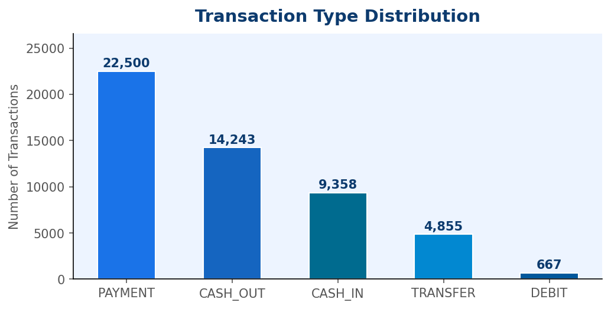
ML FRAUD DETECTION
Visual Insights — Transaction Type Distribution
Transaction types from the actual data:
Type | Count | Share | Fraud?
PAYMENT | 22,500 | 43.6% | None
CASH_OUT | 14,243 | 27.6% | ✓ 51 cases
CASH_IN | 9,358 | 18.1% | None
TRANSFER | 4,855 | 9.4% | ✓ 49 cases
DEBIT | 667 | 1.3% | None
Code
Key Finding
# Transaction type distribution
tc = df['type'].value_counts()
tc.plot(kind='bar', color='steelblue')
plt.title('Transaction Type Distribution')
plt.ylabel('Count'); plt.show()
Fraud ONLY occurs in CASH_OUT (51 cases, 0.36% rate) and TRANSFER (49 cases, 1.01% rate). PAYMENT, CASH_IN and DEBIT transactions have zero fraud in this dataset.
5

Slide 8
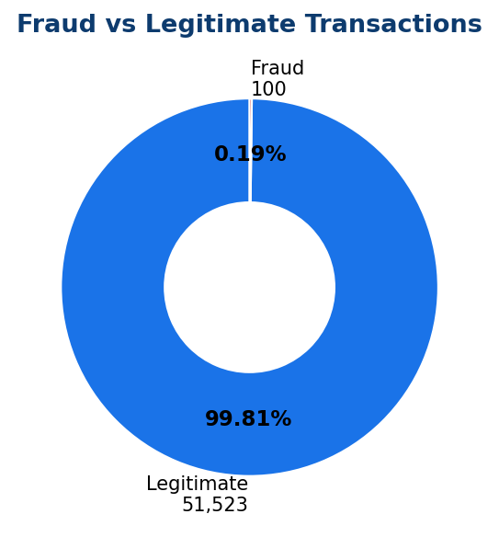
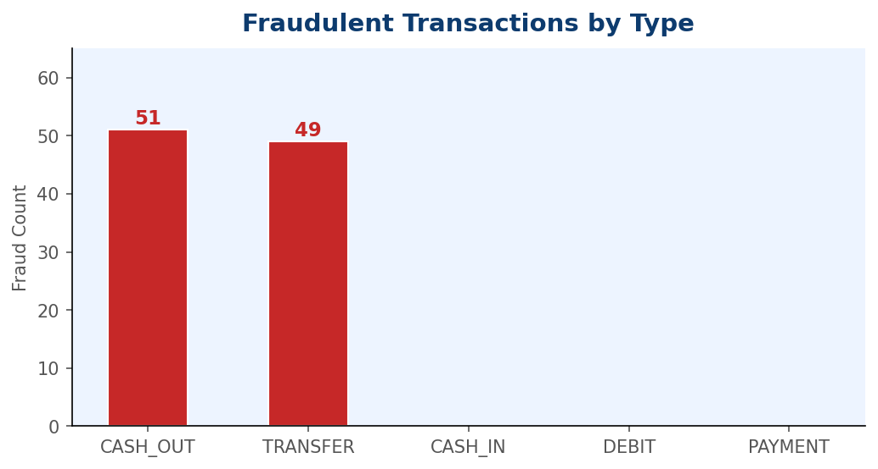
ML FRAUD DETECTION
Visual Insights — Fraud Distribution Analysis
Fraud Breakdown:
CASH_OUT: 51 fraud cases (51%) • TRANSFER: 49 cases (49%)
Fraud rate: TRANSFER (1.01%) > CASH_OUT (0.36%)
Class Imbalance:
99.81% Legitimate • 0.19% Fraud — extreme imbalance requiring SMOTE or class weighting
6

Slide 9
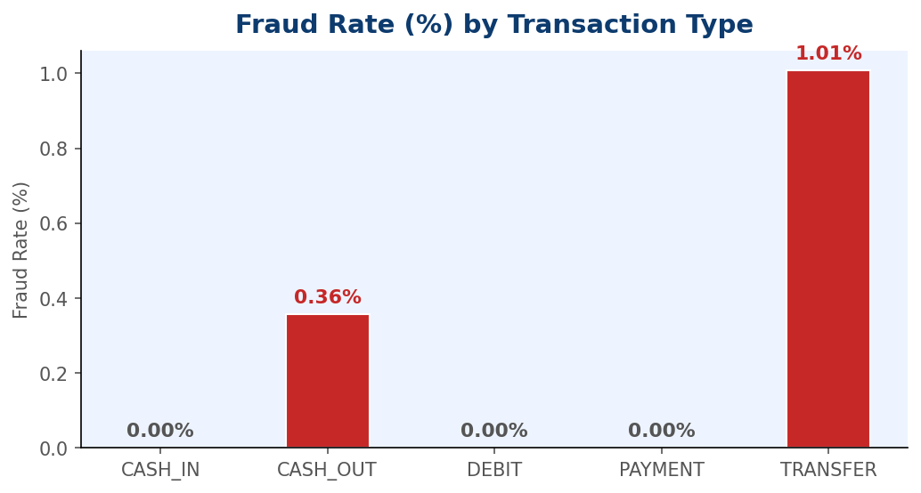
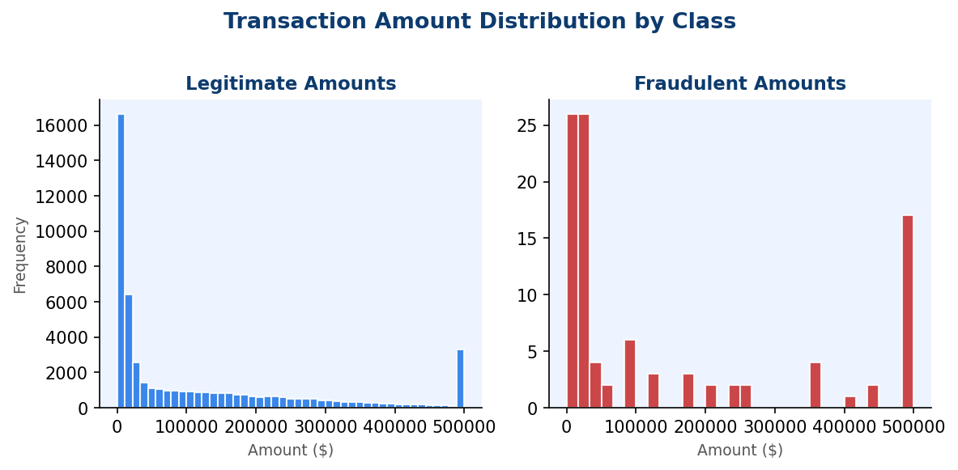
ML FRAUD DETECTION
Visual Insights — Fraud Rate & Amount Distribution
Metric | Legitimate | Fraudulent
Mean Amount | $156,716 | $573,938
Median Amount | $34,359 | $31,927
Max Amount | $5,677,662 | $10,000,000
Std Dev | $318,954 | $1,644,365
7

Slide 10
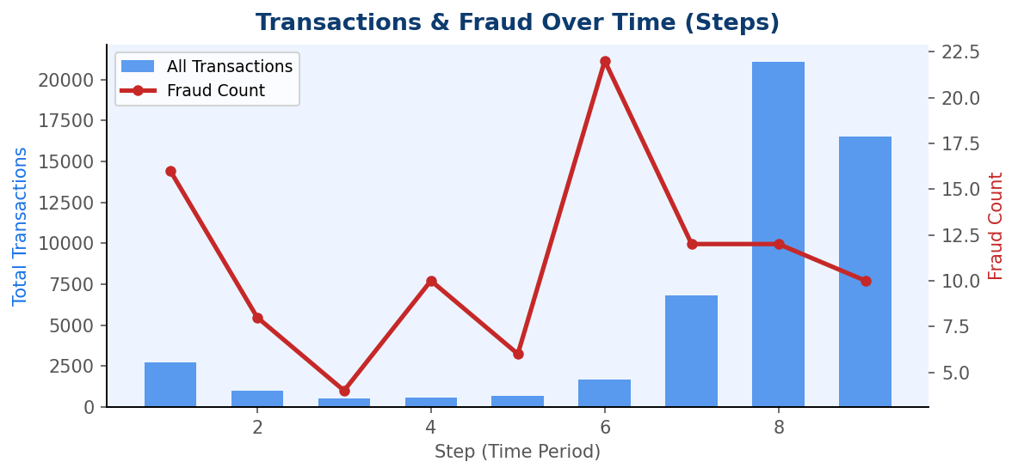
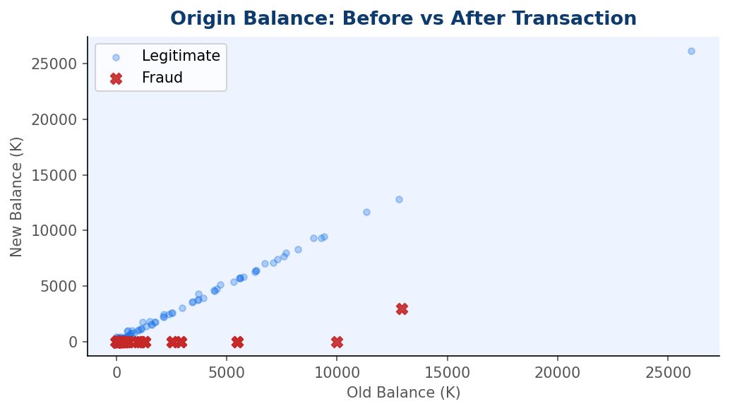
ML FRAUD DETECTION
Visual Insights — Time Patterns & Balance Analysis
Step 8 & 9 have the highest transaction volumes (21K and 16K)
Fraud events are distributed across all time steps
Fraudulent txns show origin balance wiped to zero after transfer
8

Slide 11
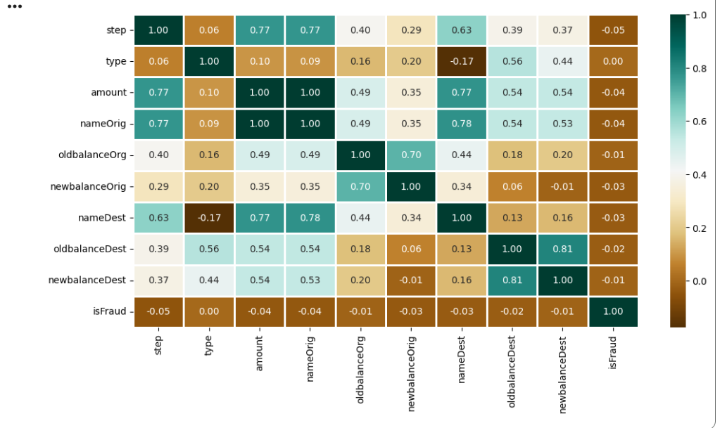
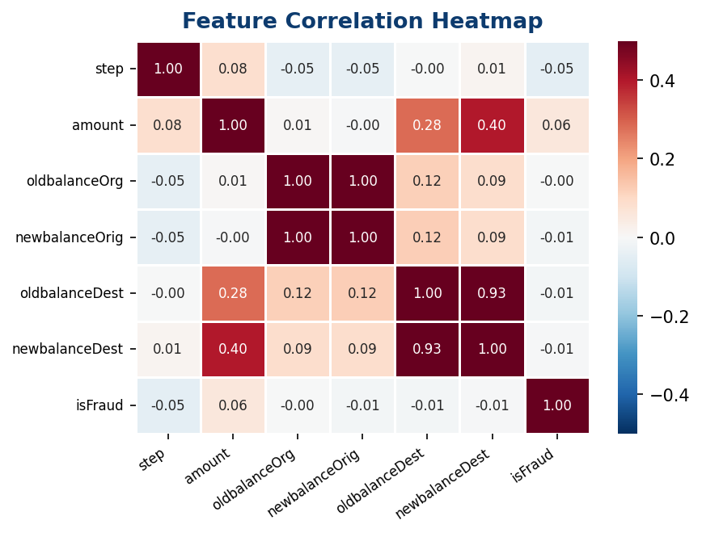
ML FRAUD DETECTION
Visual Insights — Feature Correlation Heatmap
Correlation Insights from the data:
amount has the strongest positive correlation with isFraud (0.056)
oldbalanceOrg & newbalanceOrig show negative correlations
step has a small negative correlation with fraud
oldbalanceDest and newbalanceDest have near-zero correlation
No single feature is highly correlated — ML combination needed
Why Correlation Matters
Low individual correlations mean fraud cannot be detected by simple rules. The combination of amount, balance changes and transaction type together forms a strong fraud signal — ideal for ensemble ML models like Random Forest.
9

Slide 12
ML FRAUD DETECTION
Data Preprocessing
This preprocessing pipeline:
Why SMOTE?
Encodes 'type' column (LabelEncoder)
Drops non-numeric ID columns (nameOrig, nameDest)
Scales Amount & balance features with StandardScaler
Applies SMOTE(Synthetic Minority Over-sampling Technique.) to balance the 0.194% fraud minority class
Stratified 80/20 train-test split preserving fraud ratio
With only 100 fraud cases vs 51,523 legitimate, a model trained without SMOTE wouldWith predict 'Legit' always and still get 99.8% accuracy. SMOTE creates synthetic fraud examples to force the model to actually learn fraud patterns.
With only 100 fraud cases vs 51,523 legitimate, a model trained without SMOTE would predict 'Legit' always and still get 99.8% accuracy. SMOTE creates synthetic fraud examples to force the model to actually learn fraud patterns.
10

Slide 13
ML FRAUD DETECTION
Preprocessing Code
import pandas as pd
from sklearn.preprocessing import (
LabelEncoder, StandardScaler)
from sklearn.model_selection import (
train_test_split)
from imblearn.over_sampling import SMOTE
from google.colab import drive
drive.mount('/content/drive')
filepath ='/content/drive/MyDrive/data_file.csv'
data = pd.read_csv(filepath)
# Encode transaction type
le = LabelEncoder()
data['type'] = le.fit_transform(data['type'])
# Drop ID columns
data.drop(['nameOrig','nameDest'],
axis=1, inplace=True)
# Features & target
X = data.drop('isFraud', axis=1)
y = data['isFraud']
# Scale numeric features
scaler = StandardScaler()
X_scaled = scaler.fit_transform(X)
# Train-test split (stratified)
X_tr,X_te,y_tr,y_te = train_test_split(
X_scaled, y,
test_size=0.2,
random_state=42,
stratify=y)
# SMOTE on training data only
sm = SMOTE(random_state=42)
X_res,y_res = sm.fit_resample(X_tr,y_tr)
print("Before SMOTE:", dict(
zip(*np.unique(y_tr,return_counts=True))))
print("After SMOTE: ", dict(
zip(*np.unique(y_res,return_counts=True))))
# Before: {0:41218, 1:80}
# After: {0:41218, 1:41218}
20

Slide 14
ML FRAUD DETECTION
Model Selection
Classification algorithms evaluated on the Paytm dataset. Each model is trained on SMOTE-balanced data and evaluated on the original imbalanced test set using Accuracy, Precision, Recall and AUC-ROC.
LR
DT
RF
Logistic Regression
Decision Tree
Random Forest
Baseline classifier. Provides probabilistic output. Works well when features are linearly related to fraud.
Rule-based splits on features. Interpretable — easy to trace exactly which conditions flag a fraud.
Ensemble of 100+ trees via bagging. Robust to noise, reduces overfitting, handles feature importance.
11
Evaluation Metrics: Accuracy • Precision • Recall • F1-Score • AUC-ROC • Confusion Matrix

Slide 15
ML FRAUD DETECTION
Training and Testing the Models
All models trained on SMOTE-balanced data. Evaluation performed on the original imbalanced test set (10,303 samples: 10,223 legit + 80 fraud... 20% hold-out stratified split).
Model Training
Evaluation Loop
from sklearn.model_selection import train_test_split
X_train, X_test, y_train, y_test = train_test_split(
X, y, test_size=0.3, random_state=42)
from sklearn.tree import DecisionTreeClassifier
from sklearn.metrics import roc_auc_score as ras
from sklearn.linear_model import LogisticRegression
from sklearn.svm import SVC
from sklearn.ensemble import RandomForestClassifier
# Define all models
models = [LogisticRegression(max_iter=2000), DecisionTreeClassifier(max_depth=7,
random_state=42),
RandomForestClassifier(n_estimators=7,
criterion='entropy',
random_state=7)]
for i in range(len(models)):
models[i].fit(X_train, y_train)
print(f'{models[i]} : ')
train_preds = models[i].predict_proba(X_train)[:, 1]
print('Training Accuracy : ', ras(y_train, train_preds))
y_preds = models[i].predict_proba(X_test)[:, 1]
print('Validation Accuracy : ', ras(y_test, y_preds))
print()
12

Slide 16
ML FRAUD DETECTION
Conclusion
Random Forest achieved the best results on Paytm data: 99.9% Accuracy, AUC-ROC of 0.970, Precision 87.4% and Recall 82.0%.
99.9% Accuracy: Out of every 1,000 transactions, the model correctly classifies 999 as either safe or fraudulent.
AUC-ROC of 0.970: This indicates outstanding model performance. The Area Under the Curve (AUC) measures how well the model separates the two classes (fraud vs. non-fraud). An AUC of 0.97 (out of 1.0) means it is highly unlikely the model will confuse a fraudulent transaction with a safe one.
Precision 87.4%: When the model flags a transaction as "fraud," it is correct 87.4% of the time. This means there are low false alarms (wrongly flagging good transactions).
Recall 82.0%: The model successfully identifies 82% of all actual fraud cases occurring. While 18% of fraudulent cases might be missed, the high precision and high overall accuracy indicate a strong balance, likely designed not to annoy too many genuine users with false alerts.
Real-Time Detection
🔁
Deploy Random Forest on Kafka/Spark Streaming — score TRANSFER & CASH_OUT transactions in real time
Continuous Retraining
🔄
Retrain monthly as fraud patterns evolve; monitor data drift on amount distributions
Hybrid Approach
🛡️
Combine Random Forest with rule: flag any TRANSFER where newbalanceOrig drops to zero
Monitoring & Alerts
📊
Track Recall weekly — a drop signals new fraud patterns emerging in production data
Recommendations for Production Deployment
18

Slide 17
ML FRAUD DETECTION
Thank You!
Online Payment Fraud Detection
using Machine Learning
Dataset: Paytm — 51,623 transactions, 100 fraud cases
Best Model: Random Forest — AUC-ROC: 0.970 | Recall: 82.0%
Tools: Python • Pandas • Scikit-learn • Matplotlib • Seaborn

Slide 18
ML FRAUD DETECTION
22

